Slide 1
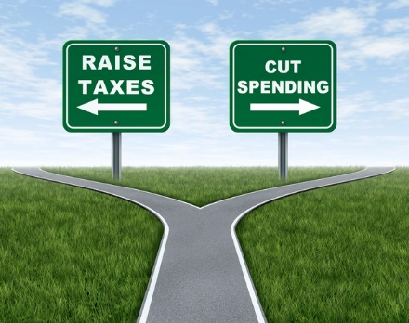
Chapter 16: Fiscal Policy
Wayne Geerling
University of Texas

Slide 2
Big Questions
What is fiscal policy?
What are the shortcomings of fiscal policy?
What is supply-side fiscal policy?

Slide 3

Fiscal Policy
The use of government’s budget tools, government spending & taxes to influence the macroeconomy.
Legislated & approved by both Congress and the president.

Slide 4
Expansionary & Contractionary Fiscal Policy
Expansionary Policy
Government increases spending or decreases taxes to stimulate or expand economy.
Leads to government deficits.
Contractionary Policy
Government decreases spending or increases taxes to attempt to slow the economy.
Pay off government deficits.
Keep economy from expanding beyond long-run capabilities.

Slide 5
Expansionary Fiscal Policy
When the economy is slowing, the prescription is for expansionary fiscal policy:
Increasing government spending:
Increasing government spending will increase AD (since G is one component of AD), which increases GDP.
Decreasing taxes:
Decreasing taxes will raise disposable income & consumption, which will also increase AD & GDP.
Notes:
\

Slide 6
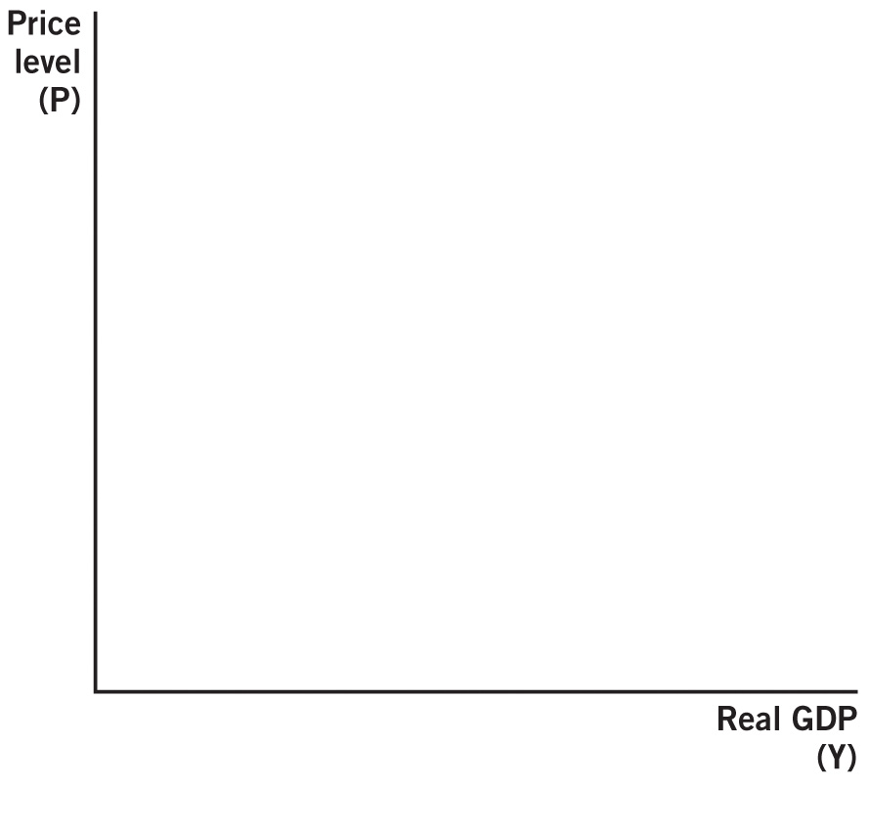

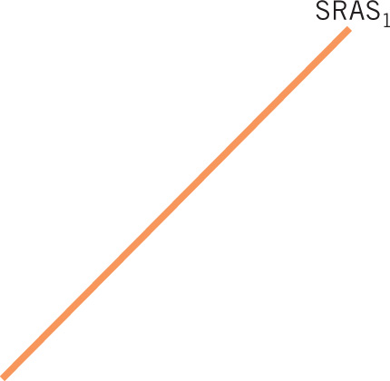


Expansionary Fiscal Policy

Slide 7
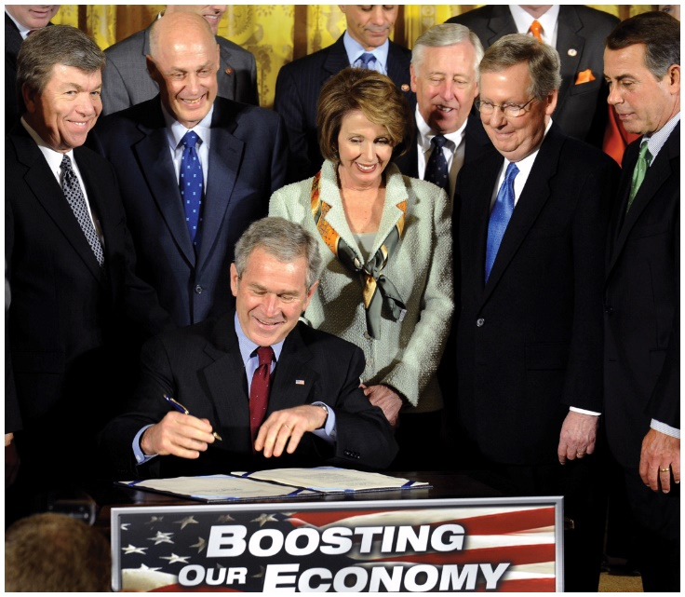
Great Recession Fiscal Policy
Economic Stimulus Act 2008:
Signed by President Bush
Tax rebate for Americans
Totaled $168 billion
Typical family of four received $1,800
Goal: Increase consumption, stimulate the economy

Slide 8
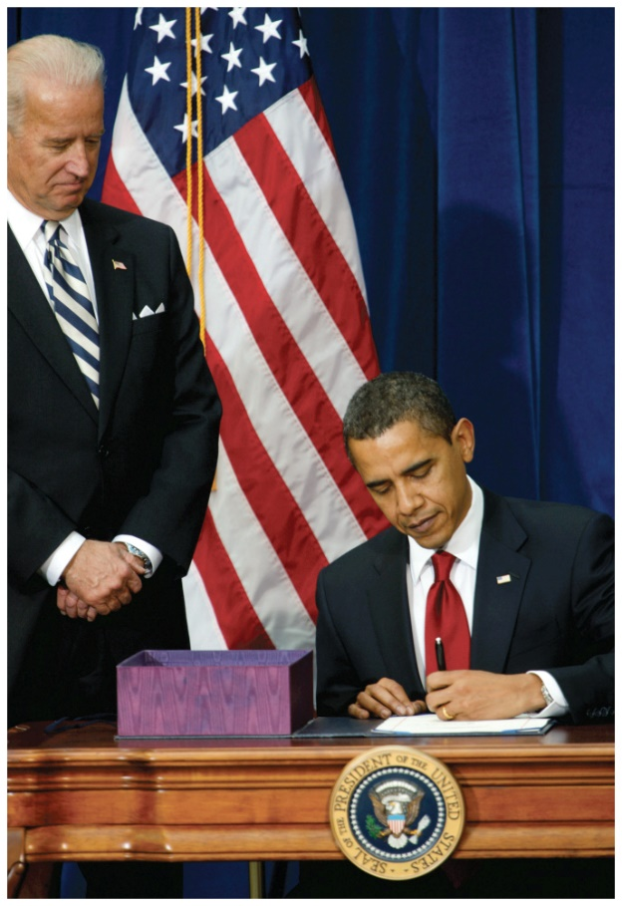
Great Recession Fiscal Policy
American Recovery & Reinvestment Act 2009:
Signed by President Obama
Focused on government spending
$787 billion stimulus
Goal: Increase AD

Slide 9
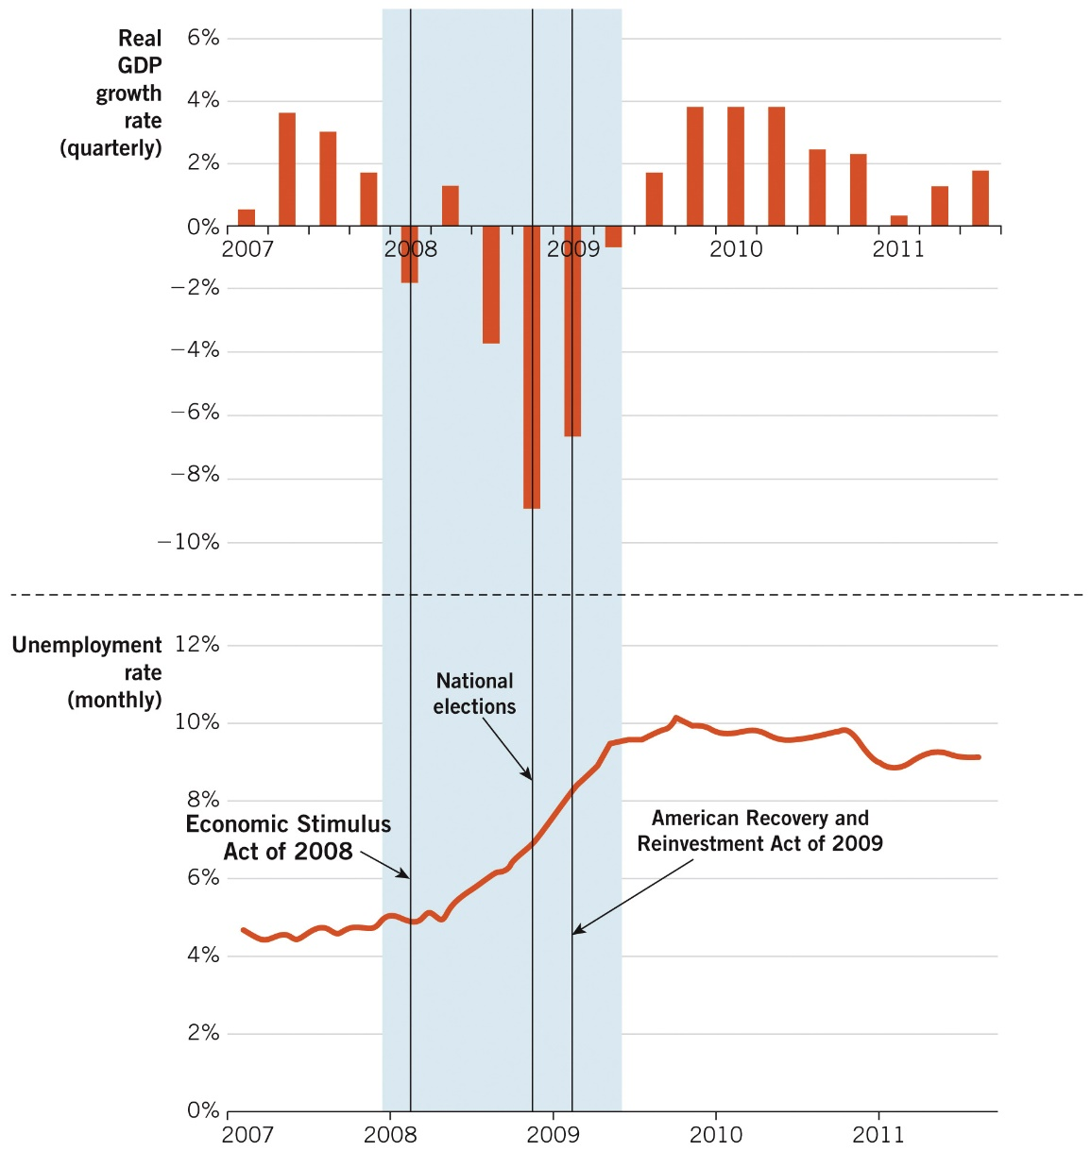
Great Recession and Fiscal Policy

Slide 10
Fiscal Policy in the COVID-19 Era
Coronavirus recession hits in March 2020.
President Trump signed the Coronavirus Aid, Relief, and Economic Security (CARES) Act that same month:
$2.2 trillion stimulus bill:
President Biden signed the American Rescue Plan Act in March 2021:
$1.9 trillion stimulus bill
Both acts allocated funds to fight the virus and to help struggling households and firms; they also provided economic stimulus checks to encourage consumption.

Slide 11
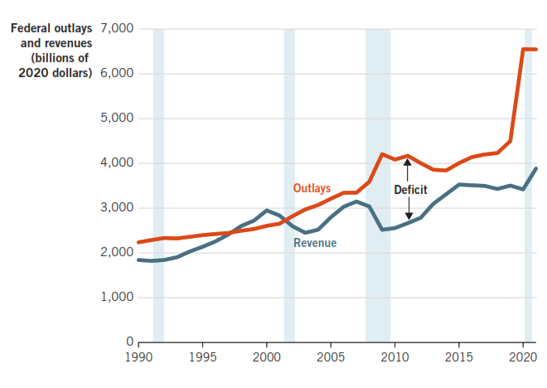
Real U.S. Outlays & Revenue, 1990–2021

Slide 12
Contractionary Fiscal Policy
Decrease AD by decreasing government spending or increasing taxes in order to:
Pay off debt that was accrued due to expansionary fiscal policy during bad times.
Slow down economy that is “overheated” from too much spending, leading to inflation
Not sustainable in the long run.
Try to reduce upward pressure on prices.
Still interested in “smoothing” out cycles.

Slide 13
Contractionary Fiscal Policy

Slide 14
Countercyclical Fiscal Policy
Fiscal policy that seeks to counteract business cycle fluctuations.
Expansionary policy during recessions.
Contractionary policy during expansions
The government tries to shift AD back to a long-run equilibrium faster than without government intervention.

Slide 15
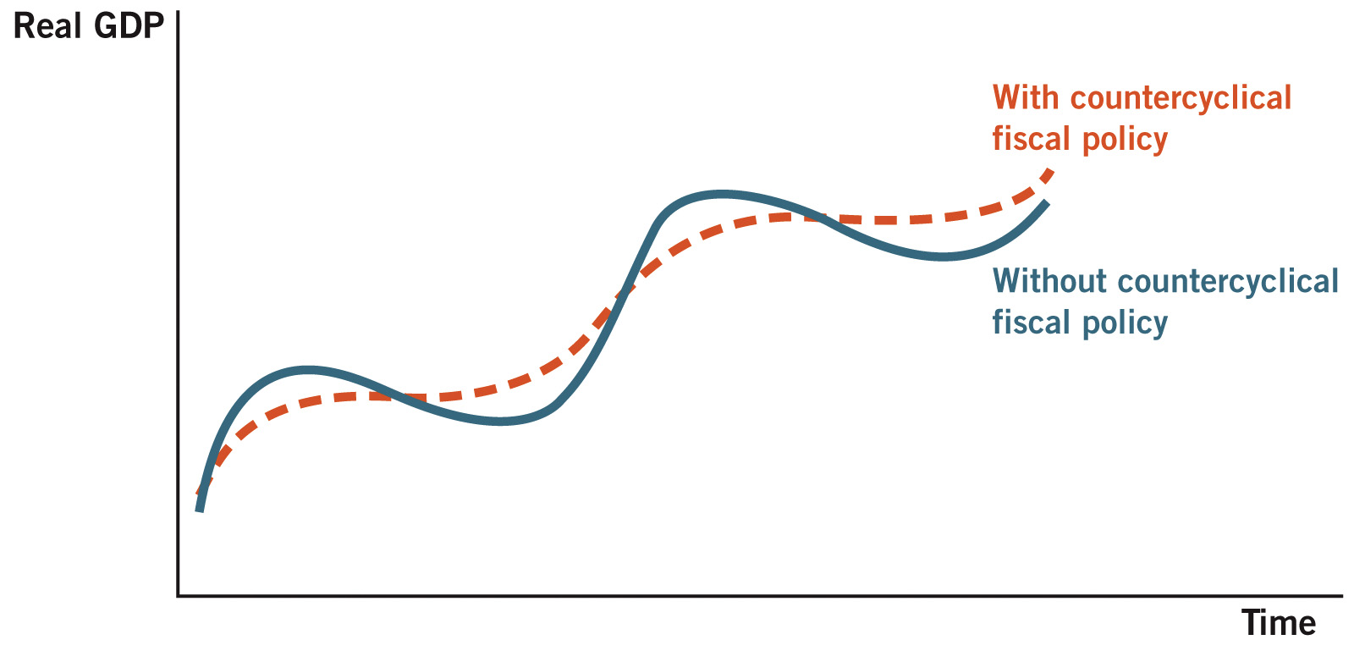
Countercyclical Fiscal Policy

Slide 16
Multipliers
The initial effects of fiscal policy can snowball over time.
Due to two central concepts:
1. Spending by one person becomes income to others.
2. Increases in income lead to increases in consumption.

Slide 17
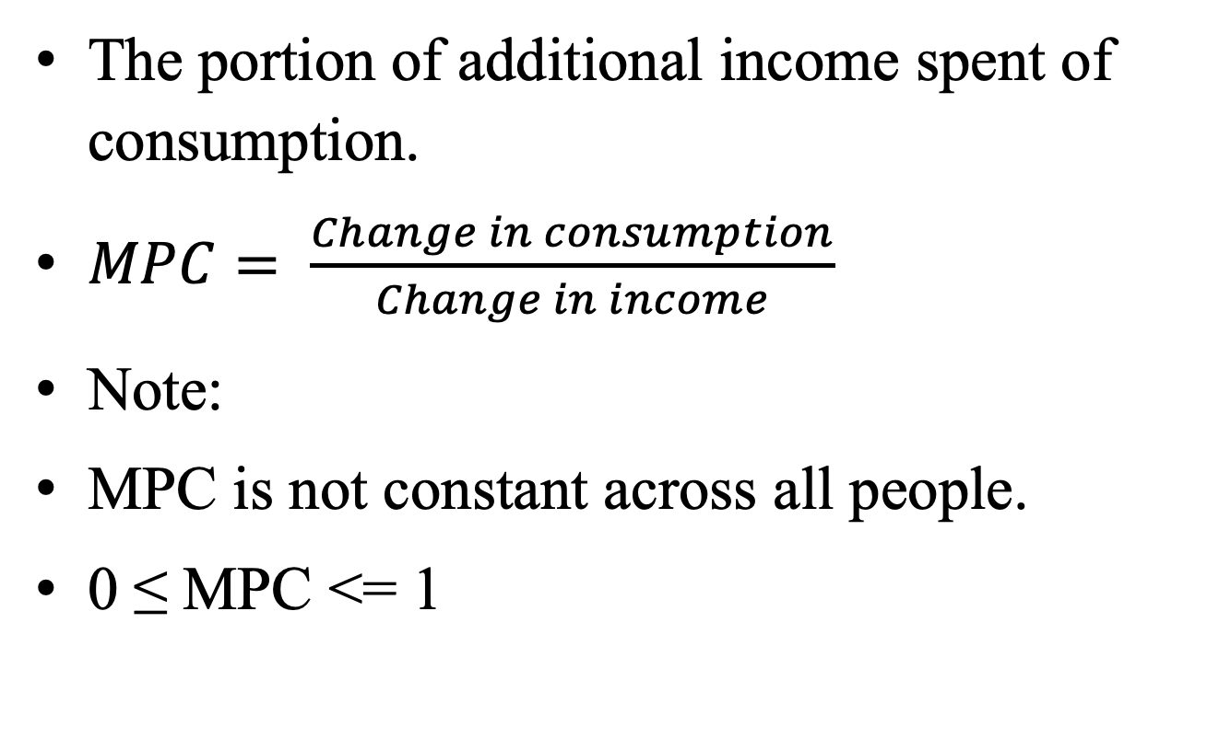
Marginal Propensity to Consume
The portion of additional income spent of consumption.
$MPC= \frac{Change in consumption}{Change in income}$
Note:
MPC is not constant across all people.
0 ≤ MPC <= 1

Slide 18
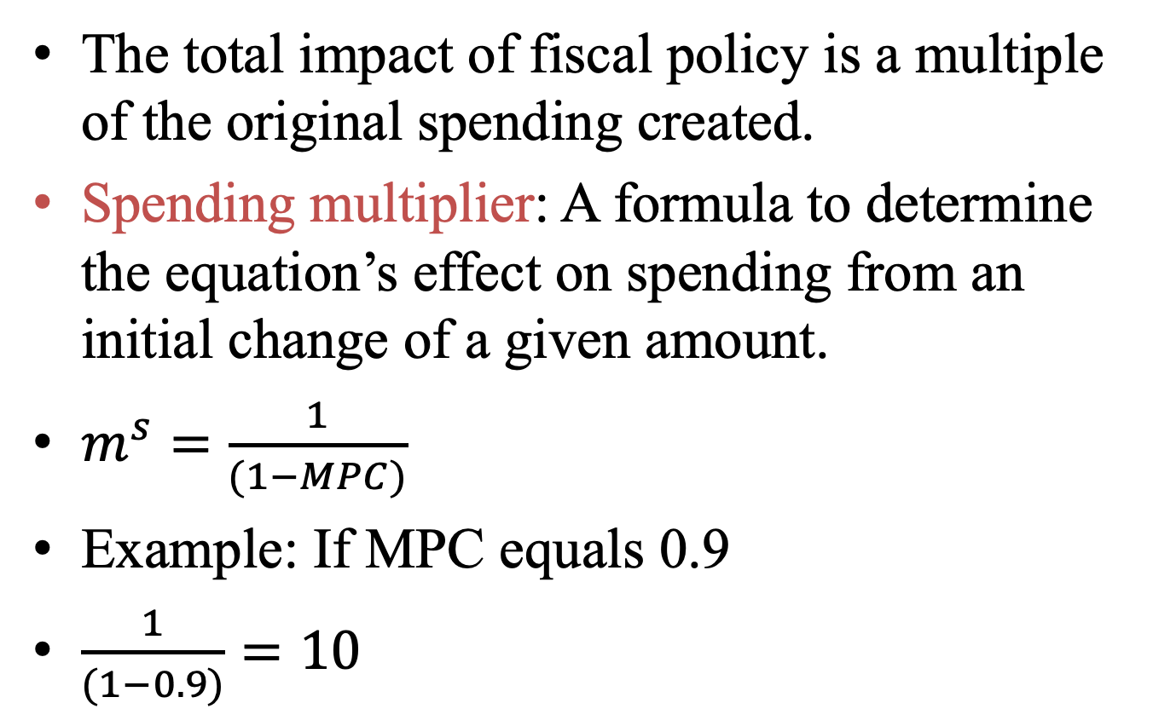
Spending Multiplier
The total impact of fiscal policy is a multiple of the original spending created.
Spending multiplier: A formula to determine the equation’s effect on spending from an initial change of a given amount.
$m^{s}=\frac{1}{(1−MPC)}$
Example: If MPC equals 0.9
$\frac{1}{(1−0.9)}=10$

Slide 19
Spending Multiplier Example
Suppose MPC = 0.75
If government increases spending by $100 billion
Workers get $ 100 billion in income, spend $75 billion.
Other people get $75 billion in income.
They spend $25 billion . . . etc.
What is the total increase in spending caused by government spending?

Slide 20
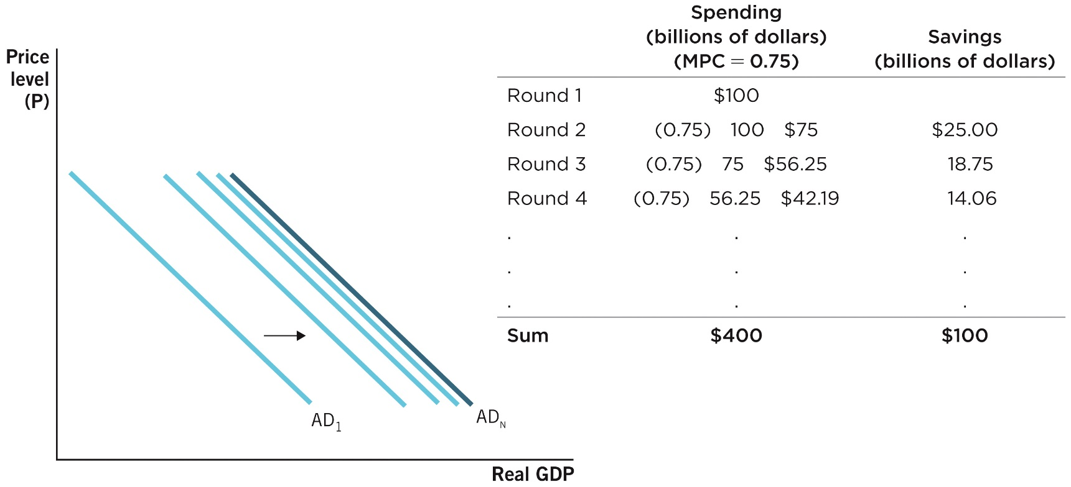
Spending Multiplier Example

Slide 21

Shortcomings of Fiscal Policy
There are 3 main reasons why fiscal policy does not always work:
Time lags
Crowding-out
Savings adjustment* (not covered)

Slide 22
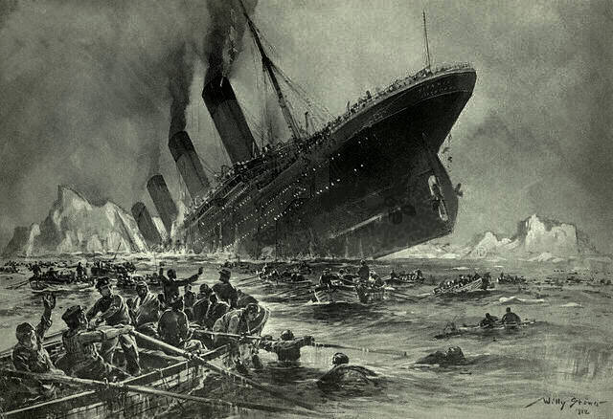
Time Lags
Recognition lag: difficult to determine when the economy is turning up or down.
GDP data is released quarterly & revised later.
Unemployment rate data lags even further.
Growth is not constant.
Implementation lag: takes time to implement fiscal policy (legislation).
Impact lag: takes time for effects of policy to materialize (multiplier effects occur over time).

Slide 23
Automatic Stabilizers
Government programs that naturally implement countercyclical fiscal policy in response to economic conditions.
Can eliminate recognition lags & implementation lags.
Examples:
Progressive income tax rates
Corporate profit taxes
Unemployment compensation
Welfare programs

Slide 24
Automatic Stabilizers
Unemployment
compensation and welfare
Tax revenues
Government Transfers and Tax Revenues
Budget surplus
Budget deficit
0
Y₂
Y_{f}
Y₁
Real GDP per Year ($ trillions)

Slide 25
Crowding-Out
When private spending falls in response to increases in government spending.
This reduces the ability of government spending to stimulate aggregate demand.
Implications:
Overall spending may not increase.
Government now has higher deficit & debt.

Slide 26
Crowding-Out Example
Government spending increases by $100 billion.
This money is borrowed, so someone had to save it.
Demand increase for loans (due to government borrowing), which increases interest rate.
This discourages private spending.
This encourages private saving.
Where is the crowding-out?
Decrease in private spending as a result of the increase in government spending.

Slide 27
Crowding-Out Example

Slide 28
Supply-Side Fiscal Policy
Use of government spending & taxes to affect the production (supply) side of the economy.
Target the LRAS curve.
Factors that shift LRAS to right: changes in resources, technology & institutions.
Policies often take time, so supply proposals are emphasized as long-run solutions.

Slide 29
Supply-Side Initiatives
Supply-side fiscal policy initiatives include:
1. R&D tax credits
2. Education policies (subsidies or tax breaks)
3. Lower corporate profit tax rates
4. Lower marginal income tax rates

Slide 30
Supply-Side Fiscal Policy

Slide 31
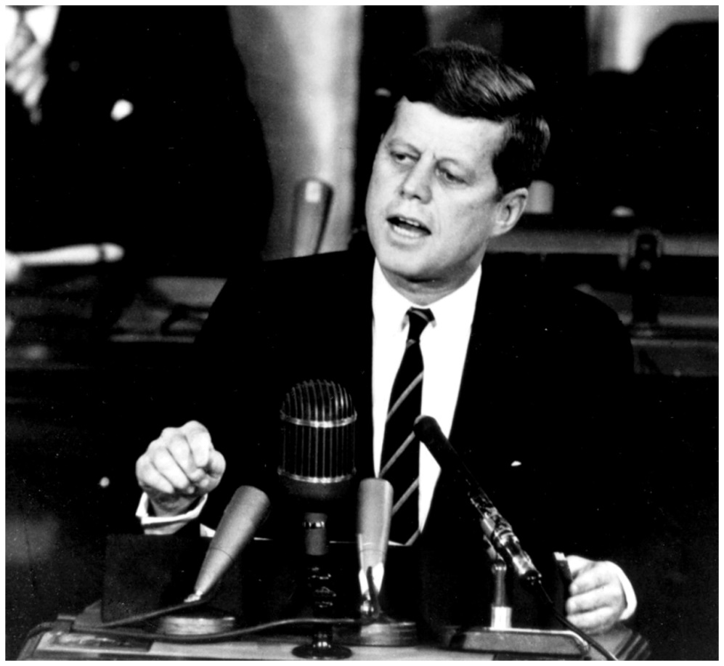
Marginal Income Tax Rates

Slide 32
Marginal Income Tax Rates
Some politicians consistently call for tax cuts, even with large deficits
Tax cuts can stimulate work effort, employment, and income.
But:
If the tax rate is too low, the government will not generate enough revenue.
If the tax rate is too high, people will work less and the tax base will shrink.
How can we find the optimal tax rate?

Slide 33
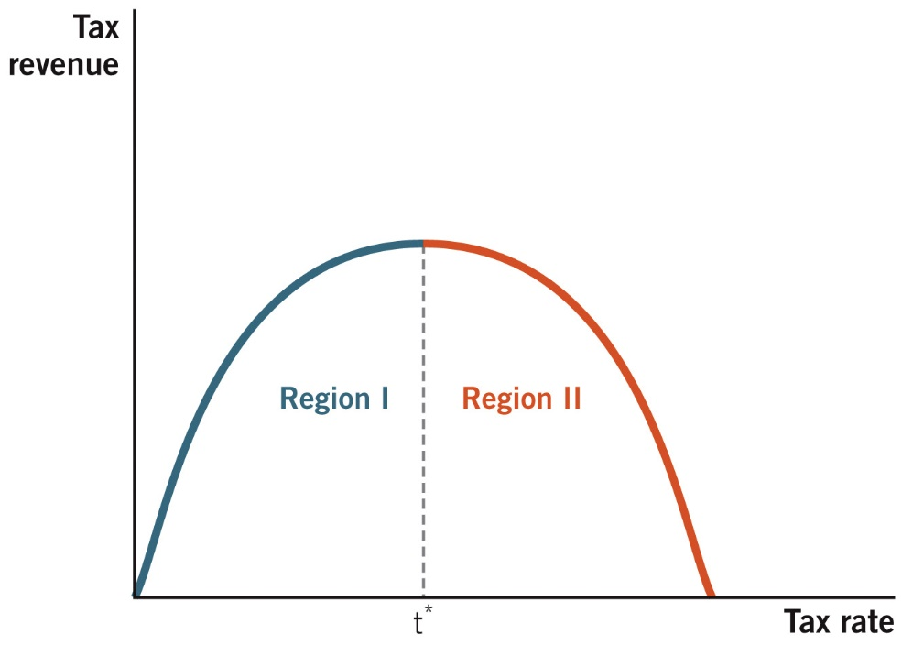
The Laffer Curve
In Region I, where tax rates are low, increases in tax rates increase tax revenue.
In Region II, where tax rates are high, increases in tax rates decrease tax revenue.

